Slide 1

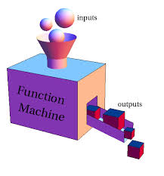

Functions and Logic Flow
Functions, Loops and Scope
SoftUni Team
Technical Trainers
Software University
http://softuni.bg

Slide 2
Table of Contents
JavaScript Functions
Syntax, Invocation, Return
For and While Loops
Scope
Local variables
Global variables

Slide 3
Have a Question?
sli.do #JS-CORE

Slide 4
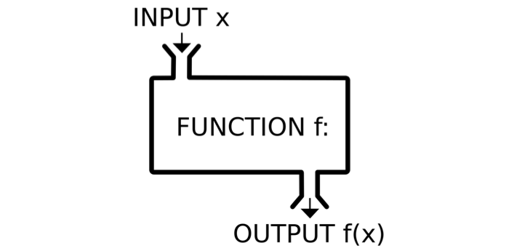
JavaScript Functions
Syntax, Invocation, Return, Functions as values

Slide 5
Functions in JS
Why Functions?
You can reuse code, define once, use many times.
Function = block of code
Can take parameters and return result
Function name: use camelCase
Function parameters: use camelCase
function printStars(count) {
console.log("*".repeat(count));
}
The { stays at the same line
Invoke the function
printStars(10);

Slide 6
Functions in JS (2)
function sum (a, b) {
console.log(a + b);
}
sum (5, 6); // 11
Invoke the function with different parameters value
function sum (a, b = 3) {
console.log(a + b);
}
sum (11); // 14
Default function parameters
function sum (a, b) {
return a + b;
}
let c = sum (5.8, 3);
console.log (c); // 8.8
Return ends function execution

Slide 7
Function Declaration, Expression, Arrow
function walk() {
console.log('walking');
}
walk(); // walking
Function Declaration
let solve = function walk() {
console.log('walking');
}
solve(); // walking
Function Expression
let solve = () => {
console.log('walking');
}
solve(); // walking
Arrow function

Slide 8
Problem: Multiplication Table
Write a JS function to create multiplication table
Based on 2 numbers, that you will receive
If the first number is greater, print "Try with other numbers.".
function multiplicationTable(numberToBeMultiplied, multiplier) {
function findWrongInput() {
if(numberToBeMultiplied > multiplier){
console.log("Try with other numbers.");
}
}
// Continues on the next slide
Check your solution here: https://judge.softuni.bg/Contests/Practice/Index/1449#0

Slide 9
Problem: Multiplication Table (2)
function printTable() {
for (let i = numberToBeMultiplied; i <= multiplier; i++) {
let result = multiplier * i;
console.log(`${i} * ${multiplier} = ${result}`);
}
}
findWrongInput();
printTable();
}
multiplicationTable(8, 3)
Try with other numbers.

Slide 10
Problem: Temperature Converter
Write a JS function to convert Fahrenheit to Celsius.
The function will receive 2 arguments: number and string
(Fahrenheit or Celsius)
If you receive any other type of input, print on the console: "Error!"
function temperatureConverter(degrees, type) {
let convertedTemperature = 0;
let correctType = false;
// Continues on the next slide
}
Check your solution here: https://judge.softuni.bg/Contests/Practice/Index/1449#1

Slide 11
Problem: Temperature Converter (2)
function convert() {
if (type.toLowerCase() === "fahrenheit") {
convertedTemperature = (((degrees - 32) * 5) / 9);
correctType = true;
} else if (type.toLowerCase() === "celsius") {
convertedTemperature = ((degrees * 9) / 5) + 32;
correctType = true;
}
}

Slide 12
Problem: Temperature Converter (3)
function print() {
if (correctType) {
console.log(Math.round(convertedTemperature));
} else {
console.log("Error!");
}
}
convert();
print();
temperatureConverter(85, "fahrenheit");
29

Slide 13
Function Invocation
The code inside a function is executed when the function is invoked with () operator
Invoke the function after declaration
function write(name) {
console.log(`I am ${name}`);
}
write('George'); // I am George
write('George'); // I am George
function write(name) {
console.log(`I am ${name}`);
}
Invoke the function before declaration

Slide 14
Function Invocation (2)
Anonymous self-invoking function
(function (count) {
for (let i = 1; i <= count; i++)
console.log('+'.repeat(i));
})(4);
+
++
+++
++++
This is called "closure" (a state is closed inside)
let f = (function () {
let x = 0;
return function() { console.log(++x); }
})(); f(); f(); f(); f();
1
2
3
4

Slide 15
Function Return
Return statement ends function execution
function getRectArea(width, height) {
if (width > 0 && height > 0) {
return width * height;
}
return 0;
}
console.log(getRectArea(3, 4)); // 12
console.log(getRectArea(-3, 4)); // 0
let result = function (a, b) {
return a % b;
};
console.log(result(10, 3)); // 1

Slide 16
Variables Holding Functions
In JS variables can hold functions as their values
let f = function(x) { return x * x; }
console.log(f(3)); // 9
console.log(f(5)); // 25
f = function(x) { return 2 * x; }
console.log(f(3)); // 6
console.log(f(5)); // 10
f = undefined;
console.log(f(3)); // TypeError: f is not a function(…)

Slide 17
Functions as Parameters
function repeatIt(count, func) {
for (let i = 1; i <= count; i++)
func(i);
}
let starsFunc = function(i) {
console.log("**".repeat(i))
};
repeatIt(3, starsFunc);
repeatIt(3, function(x) {
console.log(2 * x);
});
**
****
******
2
4
6

Slide 18
Problem: Count Occurrences of a Given Character
Write a JS function that finds occurrences of а character in а string
Takes 2 parameters – string and character
Finds the count of occurrences of the given char in the given string
Checks if the count is even / odd
Print on the console: 'Count of {char} is even/odd.'
countChars('Is this real life?', 'f');
Count of f is odd.
Check your solution here: https://judge.softuni.bg/Contests/Practice/Index/1449#2

Slide 19
Problem: Count Occurrences of a Given Character
function countChars(string, char) {
let count = 0;
function findCharacterCount() {
for (let i = 0; i < string.length; i++) {
if(string[i] === char){
count++;
}
}
}
...
}
function evenOrOddCount() {
if (count % 2 === 0) {
console.log(`Count of ${char} is even.`);
} else {
console.log(`Count of ${char} is odd.`);
}
}
findCharacterCount();
evenOrOddCount();

Slide 20
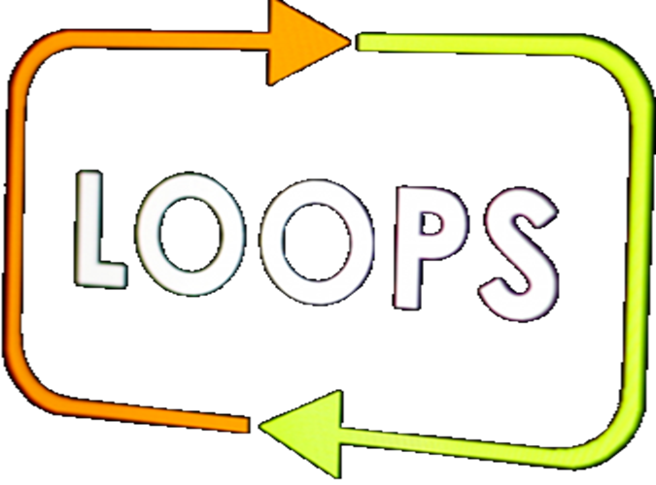
Loops in JS
For…in, For…of, While

Slide 21
Loops: for…in
The for / while loops work as in C++, C# and Java
For…in loop is used to iterate over the enumerable properties of objects
for…in loop iterates over the indexes
function solve(arr) {
for (const arrElement in arr) {
console.log(arrElement);
}
}
solve(['George', 5, null, 54]);
0
1
2
3

Slide 22
Loops: for…in
function solve(str) {
for (const character in str) {
console.log(str[character]);
}
}
solve('Hello');
H
e
l
l
o
function solve(obj) {
for (const objElement in obj) {
console.log(objElement);
}
}
solve({name: 'Peter', age: 32, town: 'Sofia'});
name
age
town

Slide 23
Loops: for…of
For…of loop is used to iterate over the iterable objects
function solve(arr) {
for (const arrElement of arr) {
console.log(arrElement);
}
}
solve(['George', 5, null, 54]);
George
5
null
54

Slide 24
Loops: for…in
function solve(str) {
for (const character of str) {
console.log(character);
}
}
solve('Hello');
H
e
l
l
o
function solve(obj) {
for (const objElement of obj) {
console.log(objElement);
}
}
solve({name: 'Peter', age: 32, town: 'Sofia'});
TypeError: obj is not iterable

Slide 25
Loop: while
The while loops through a block of code as long as a specified condition is true.
function count(num) {
while (num < 200) {
console.log(num *= 2);
}
}
count(5); // 10 20 40 80 160 320
function count(arr) {
while (arr.length>0) {
console.log(arr.length);
arr.length-=1;
}
}
count(['Peter', 45, 0, 58]); // 4 3 2 1

Slide 26
Problem: Unique Characters
Write a JS function that takes one string parameter and extract only the unique characters from the string except for whitespaces.
function extractUniqueChars(string) {
let uniqueChars = "";
function findUniqueChars() {
for (let i = 0; i < string.length; i++) {
isCharWhiteSpace(i);
isCurrentCharUnique(i);
}
}
// Continues on the next slide
}
Check your solution here: https://judge.softuni.bg/Contests/Practice/Index/1449#3

Slide 27
Problem: Unique Characters (2)
function isCharWhiteSpace(i) {
if (string[i] === " ") {
uniqueChars += string[i];
}
}
function isCurrentCharUnique(i) {
if (uniqueChars.indexOf(string[i]) === -1) {
uniqueChars += string[i];
}
}
findUniqueChars();
return uniqueChars;
console.log(extractUniqueChars("Doggos are FunnNn"));
Dogs are FunN

Slide 28
Scope
Local and global scope

Slide 29
Scope
Scope is the visibility of functions and variables in the different parts of your code during runtime.
Global Scope – Global variables can be accessed from anywhere in a JavaScript function
var name = 'Maria’; // code here can use name function myFunction() {
console.log(name); // code here can also use name }
myFunction(); // Maria
console.log(name); // Maria

Slide 30
Scope (2)
Function Scope – Local variables can only be accessed from inside the function where they are declared
Block Scope - Variables declared inside a block {} can not be accessed from outside the block.
function myFunction() { var name = 'Maria'; // only here code CAN use name }
console.log(name);
ReferenceError: name is not defined
{ let x = 2; } // x can NOT be used here

Slide 31
Automatically global
We can assign a value to a variable that has not been declared and it automatically become a Global variable
Invoke the function before declaration
myFunction();
console.log(name); // Maria
function myFunction() { name = 'Maria'; }

Slide 32
Automatically global (2)
Global variables are not created automatically in 'Strict Mode'
'use strict'
myFunction();
console.log(name); // ReferenceError: name is not defined
function myFunction() { name = 'Maria'; }

Slide 33
Problem: Special Words
Write a JS function that:
Takes 5 parameters – integer, integer, string, string, string.
Iterates from the first number to the second one.
For numbers which are multiples of both 3 and 5, print all 3 strings
For multiples only of 3, print the second string
For multiples only of 5, print the third string
9 pesho
10 test
11
12 pesho
13
14
15 doggo-pesho-test
specialWords(9, 15, "doggo", "pesho", "test");
Check your solution here: https://judge.softuni.bg/Contests/Practice/Index/1449#4

Slide 34
Problem: Special Words (2)
function specialWords(startNum, endNum, firstWord, secondWord, thirdWord) {
function checkCurrentNumber(i) {
if (i % 3 === 0 && i % 5 === 0) {
console.log(`${i} ${firstWord}-${secondWord}-${thirdWord}`);
} else if (i % 3 === 0) {
console.log(`${i} ${secondWord}`);
} else if (i % 5 === 0) {
console.log(`${i} ${thirdWord}`);
} else {
console.log(i);
}
}
for (let i = startNum; i <= endNum; i++) {
checkCurrentNumber(i);
}
}

Slide 35


Live Exercises

Slide 36

Summary
Arrow functions ≈ short function syntax
Function = named piece of code
Syntax, invocation, return
Loops – for…in, for…of, while
Local and global scope
function calcSum(a, b) {
let sum = a + b;
return sum;
}

Slide 37
https://softuni.bg/courses/javascript-fundamentals

Slide 38












SoftUni Diamond Partners

Slide 39




SoftUni Organizational Partners

Slide 40




Trainings @ Software University (SoftUni)
Software University – High-Quality Education and Employment Opportunities
softuni.bg
Software University Foundation
http://softuni.foundation/
Software University @ Facebook
facebook.com/SoftwareUniversity
Software University Forums
forum.softuni.bg

Slide 41

License
This course (slides, examples, demos, videos, homework, etc.) is licensed under the "Creative Commons Attribution-NonCommercial-ShareAlike 4.0 International" license

